Slide 1
Project Cost estimating, Thresholds, and Other considerations
ED VENABLE DALE MCKEEL

Slide 2
Sidewalks Examples
Durham’s average
sidewalk construction cost is $50 per Linear Foot

Slide 3
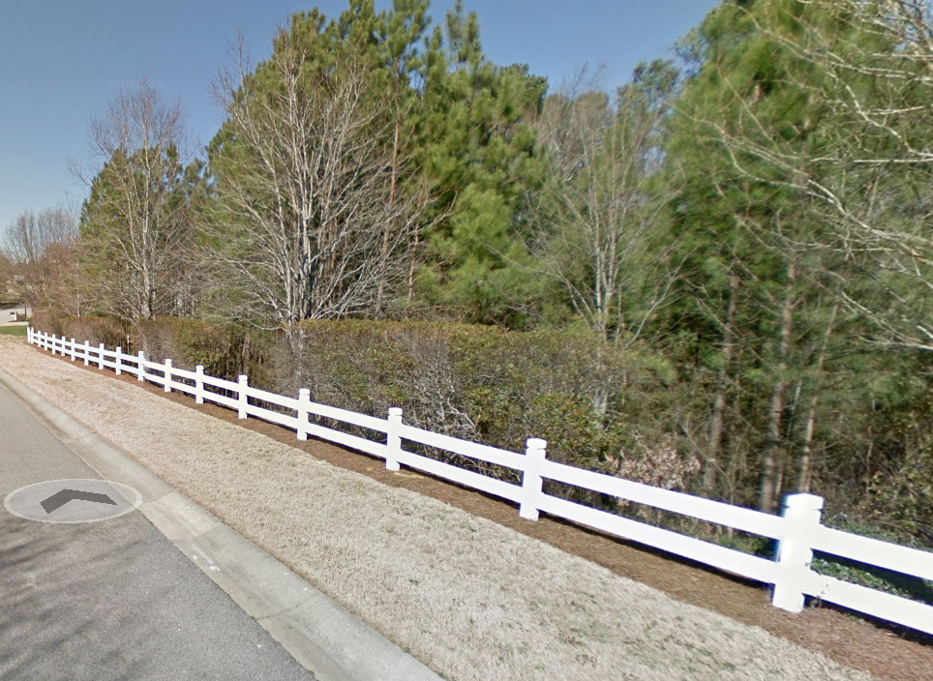

Slide 4
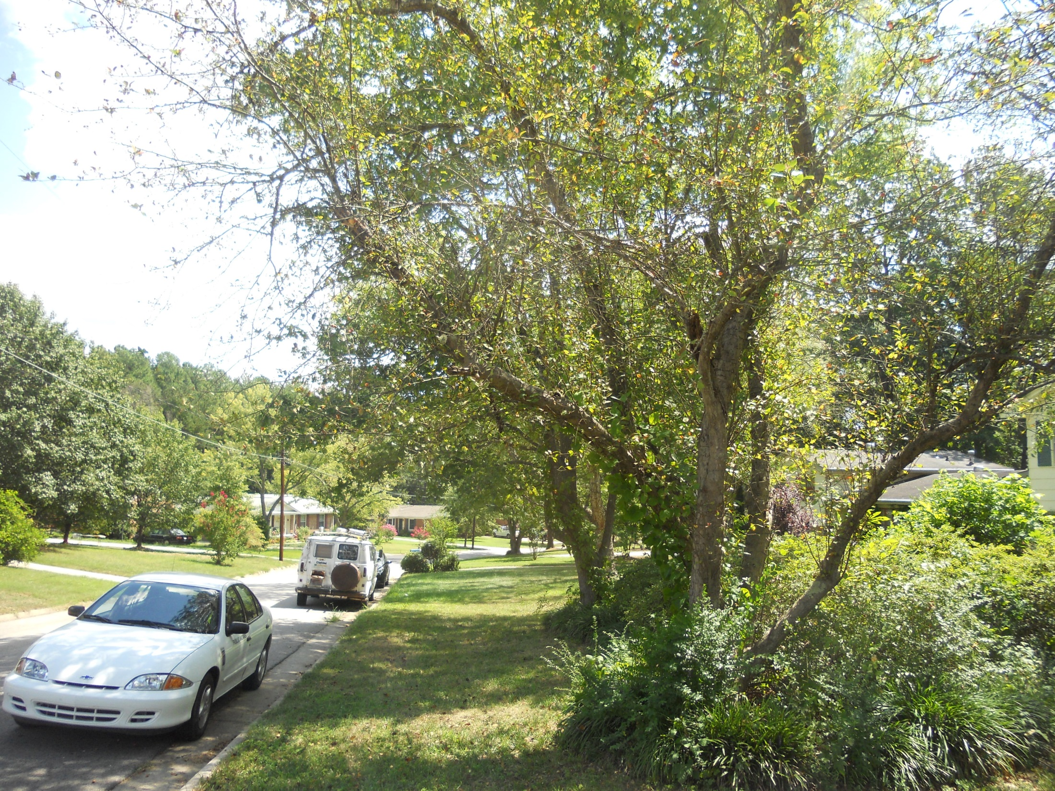

Slide 5
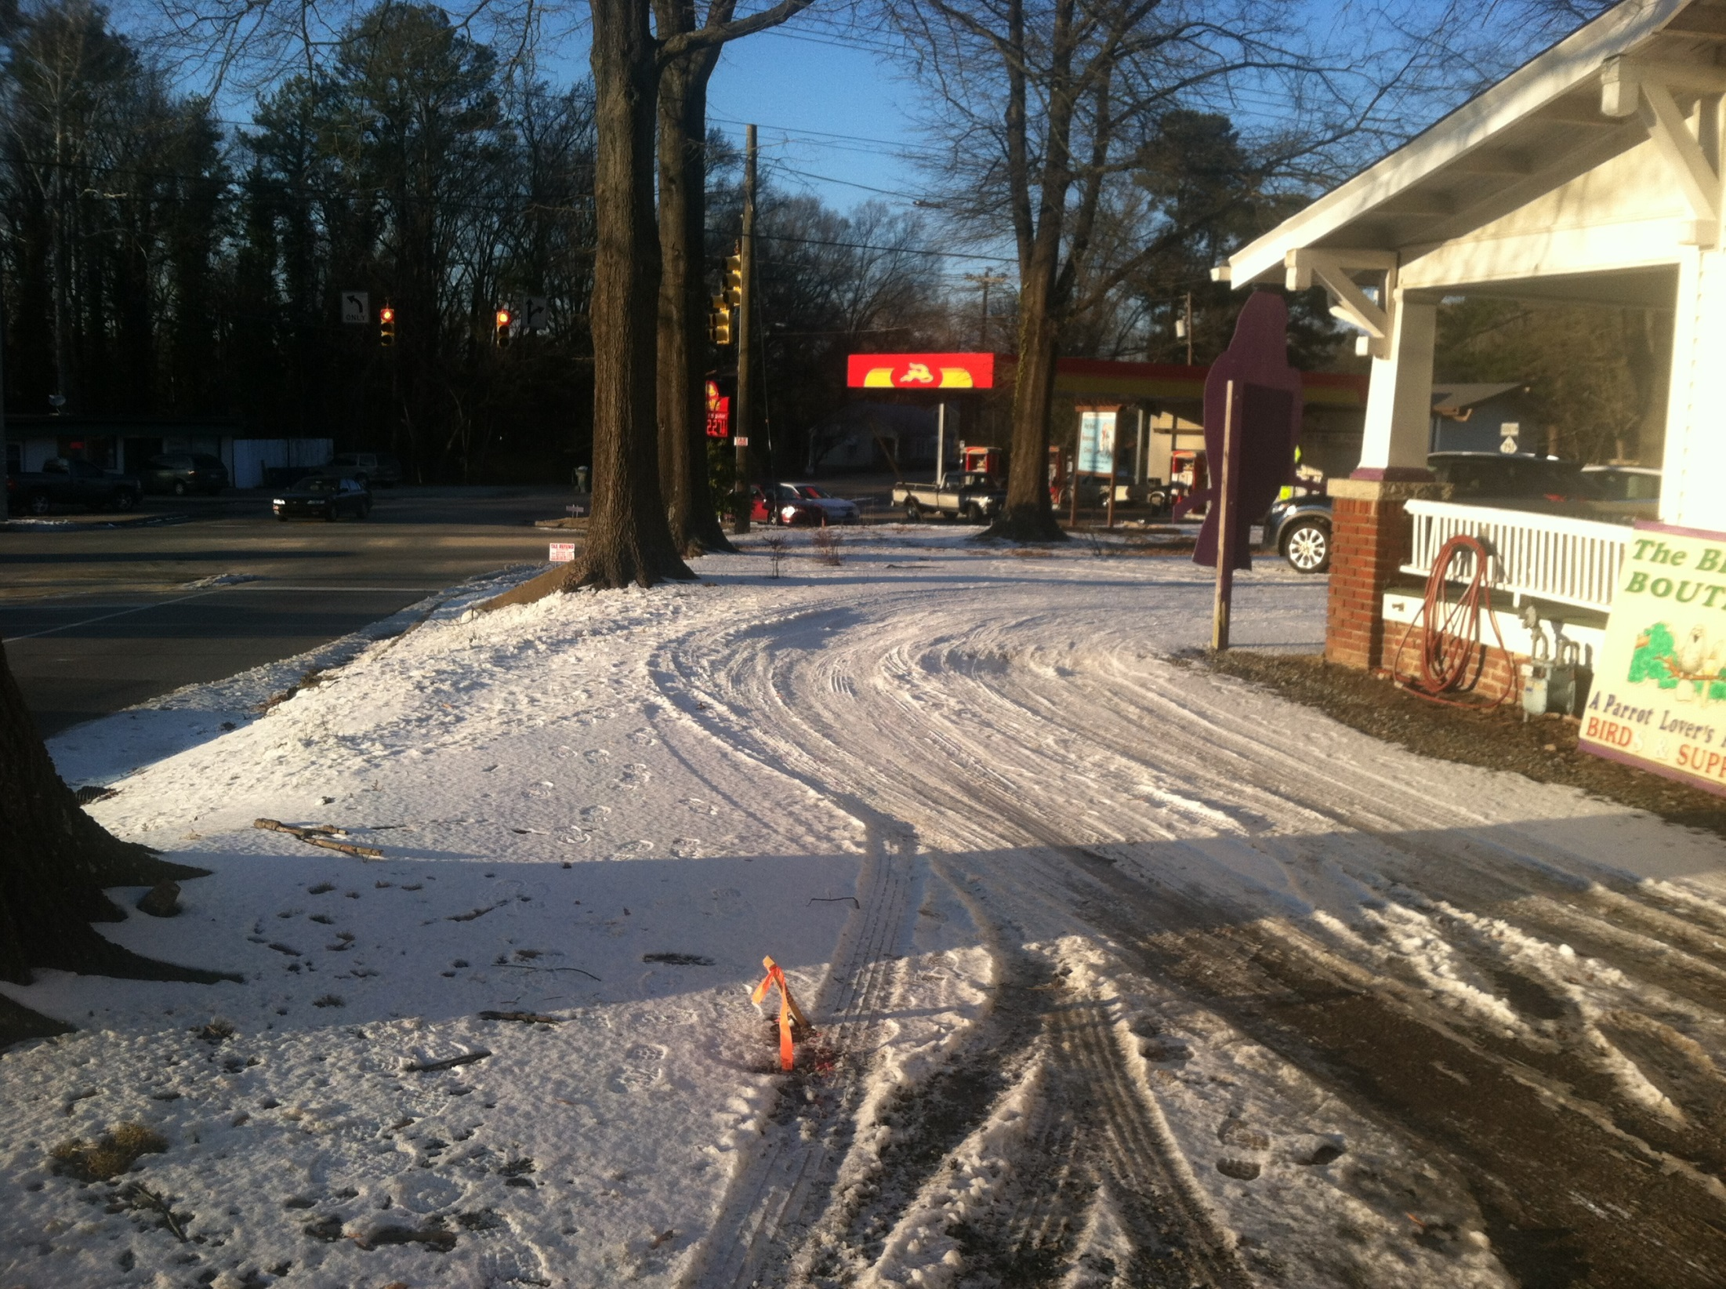

Slide 6
Description of Expenditures
Design
Environmental Documentation
ROW Acquisitions & TCEs
Utility Relocation (Duke Energy, TW, Frontier)
Construction & Contingency
Construction Administration & Inspection
Testing
NCDOT Staff Time Reimbursement

Slide 7
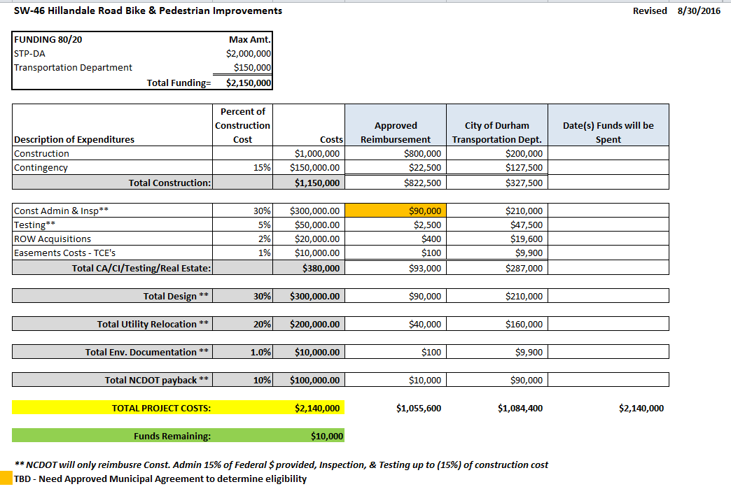

Slide 8
PROJECT COST THRESHOLDS
SPOT 4.0 - $100,000
City of Durham ~ $500,000

Slide 9
Cost estimating – Two approaches used in Durham
Cost estimating spreadsheet
Consultant estimates
Functional design process – 4 bike/ped corridors
Priority trails study

Slide 10
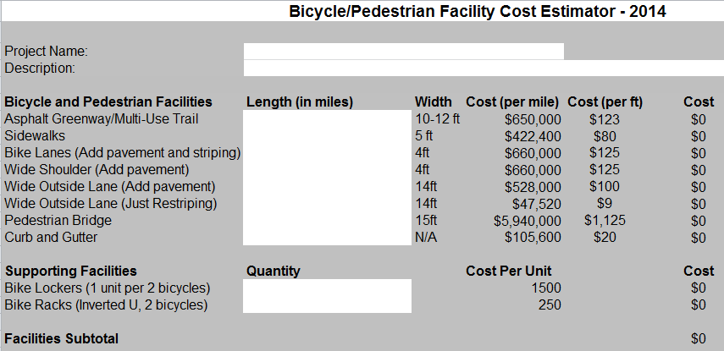
Cost estimating spreadsheet (Top)

Slide 11
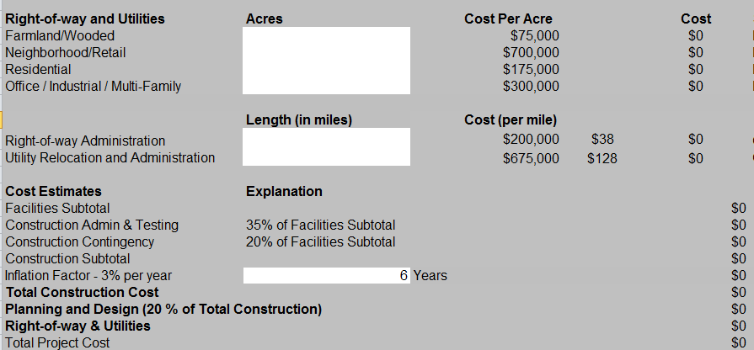
Cost estimating spreadsheet (Bottom)

Slide 12
Functional design
Consultant performed the following:
Public Involvement
Topographic Corridor Map
Recommended Typical Sections
Permitting Assessment
Detailed Cost Estimate

Slide 13
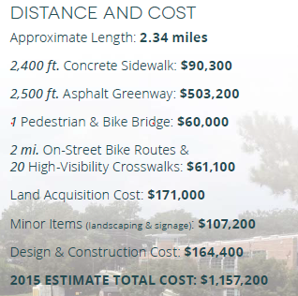
Priority trails study

Slide 14
Questions?
Thank you!

