Slide 1
Contract Proposals
Procurement
Concurrence in Award
Construction Oversight
Michael J. Kneis, PE
Division Project Delivery Engineer

Slide 2
What is needed before advertising for construction?
Plans prepared in accordance with 2012 NCDOT Standard Specifications for Roads and Structures.
Federal or State environmental document(s)
Permits (if required)
Specifications (including special provisions)
Municipal Agreement
Engineer’s estimate
DBE or MB/WB Goals set by NCDOT
ROW Certification
Utilities Relocated (or schedule)
Construction Authorization

Slide 3
Proposals
Contract Proposal (part of the Specifications) will include Federal or State provisions that apply to the entire project.
Don’t use ADA or EJCDC front end documents - causes conflicts!
Use Line-Up Sheet – see LPMO Website for info
Check effective dates for Specs when updating proposals.
Make sure pay items match specification AND plans – use standard pay items
NCDOT must approve it.

Slide 4
Special or Proprietary Items
Avoid if at all possible.
If using name brand items, must list 3 brands and also “or equivalent”.
Specialty Items MUST be approved well in advance of letting.
i.e. Trash cans on a streetscape project where matching existing trashcans on previous projects is desired. Approval could take several weeks!

Slide 5
Things we want to see
Allow enough time prior to let for reviews, corrections, and funding authorization
Proposal that does not have previous project descriptions
No misspelled words and grammar errors
Ensure pay items are complete and match what is in the proposal
NCDOT bond forms and correct insurance bond amounts
Requested changes made in subsequent submittal

Slide 6
Tips to think about
Contact your NCDOT Program Management Office with questions
Advise NCDOT of an impending submittal
Does your engineer’s estimate fully capture the scope of work proposed and is it realistic?
Is my first submittal 100% complete and correct?
Is there other municipal work in the project area that could affect this project?
Is my contract time realistic

Slide 7
Tips to think about (continued)
Anticipated R/W impacts, not only for construction but for utility relocation
Utility impacts and associated time for design and relocation
Constructability issues
Liquidated damages
Costs associated with contract administration
Timeline for solicitation and securing private engineering firms for design and contract admin/CEI work

Slide 8
Let, Concurrence, Award
LET = Bid Opening, not Advertisement
Steps to get to Let:
Follow NCGS 136, not 143 – you got money from DOT!
Advertise a minimum of 3 weeks
Use NCDOT prequalified contractor list, not Municipal list, not resume based
Receive sealed bids
Public opening
Must accept lowest responsive and responsible bid

Slide 9
Let, Concurrence, Award
Items needed for Concurrence
Letter from Town requesting Concurrence
Bid Tabs
All forms filled out by bidders
Letters of Intent from Subs listed to meet goals
Resolution from Council OR proof of delegation to Manager, etc.
Division Concurrence limit is $2.5 million
Anything above will need to go to Raleigh

Slide 10
Let, Concurrence, Award
Once you receive NCDOT’s concurrence, only THEN can you execute the contract.
Invite NCDOT to Preconstruction Meeting
Set expectations up front

Slide 11
Construction Oversight
Your Responsibilities:
Daily Inspection/Observation
Testing by NCDOT Certified Inspectors at frequency required by DOT Specs.
Get Change Orders approved by NCDOT PRIOR to the contractor doing the work, even if it’s only for time. Must be on NCDOT Form 880LG
Oversight
NCDOT Responsibilities:
Answer your questions
Review Change Orders and Claims.
Audit

Slide 12
Construction Oversight
Construction Administration is accomplished by the LGA in accordance with the NCDOT Construction Manual.
NCDOT must accept the final project before you release your contractor
NCDOT must accept the final project before final reimbursement can be made.

Slide 13
CEI Construction Inspection & Oversight
All professional services must be prequalified by NCDOT for the requested work codes.
Requirements must be publicly announced.
Services must be selected on the basis of qualifications.
LGA is responsible NCDOT providing review and concurrence of tasks, man-hours and rates.
Develop an RFQ using template provided by NCDOT
Develop an estimate of costs
Advertise or otherwise solicit for professional services
Review and select most qualified consultant.

Slide 14
CEI Construction Inspection & Oversight
Review and select most qualified consultant.
Request a cost proposal from selected consultant
Submit letter in the Project Management Tool with overview of selection process (use template) and include proposal from consultant.
Allow one month for review and comments or concurrence by NCDOT.

Slide 15
CEI Construction Inspection & Oversight
NCDOT policy prohibits same consultant for design and CEI.
Request for exception to policy must be made in writing to LPMO.
Reviewed and approved/denied by the Construction Unit.
The exemption is for PE firm to COMPETE for, not to perform CEI. If approved, cannot automatically extend PE contract to cover CEI – must undergo new solicitation.

Slide 16
What makes a good project?

Slide 17
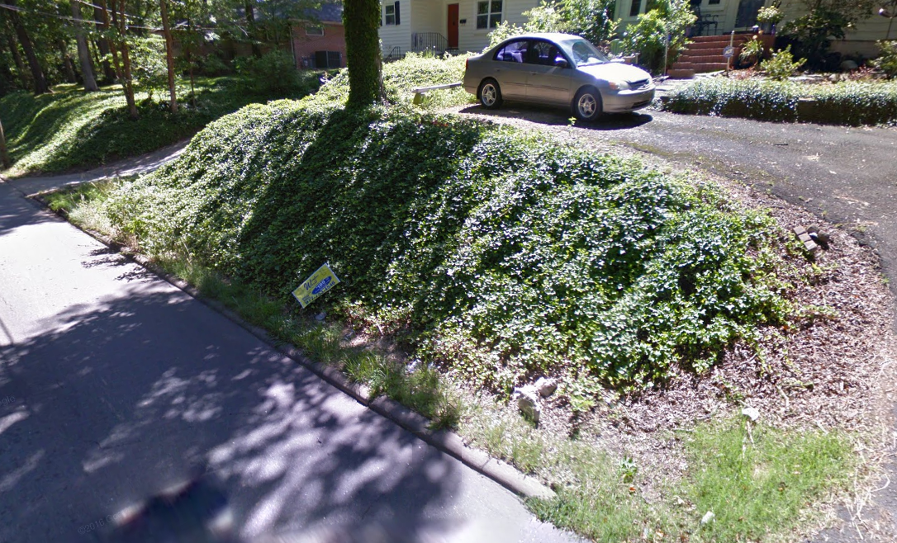
What makes a good project?

Slide 18
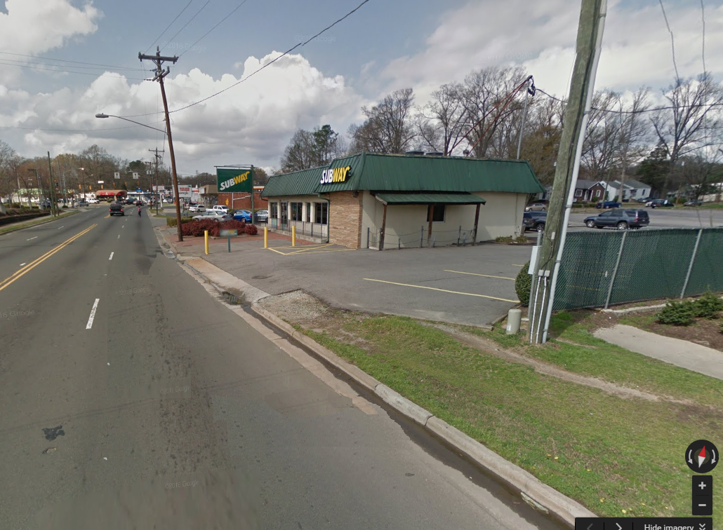
What makes a good project?

