Slide 1
FHWA Funding, Monitoring & Reporting
NCDOT Local Project Delivery
Tammy Richards - FHWA

Slide 2
Funding Categories
Transportation Alternatives Program (TAP)
TAP now incorporates Transportation Enhancement (TE) & Safe Routes To Schools
(SRTS) funds
Transportation, Community and System Preservation (TCSP)
Congestion Mitigation and Air Quality (CMAQ)
Surface Transportation Program (STP-DA)

Slide 3
Common Terms
Contract Authority U.S. Congress: “You (NCDOT) might be able to obligate X dollars . . .” Obligation Ceiling (or Obligation Limitation) “. . . but, based on overall budget conditions, you can only obligate Y dollars” Funds programmed (not yet guaranteed) NCBOT adopts a new "Funding Program" (7-year STIP) every two years Funds obligated (safe from rescission axe) Upon NCDOT request, FHWA agrees to reimburse for a specific project Rescission (“Houston, we have a problem”) Congress decreases the State’s Contract Authority

Slide 4
Project/Funds Authorization
FHWA commitment that Federal funds are available for the project
1.Preliminary Engineering (PE) – (you have 10 years to construct the project – “Studies” are not a good idea)
2. Right of Way acquisition (ROW)
3. Construction (CON)
Authorization is required prior to incurring any expenses
Work done before the date of FHWA Division authorization is NOT eligible for reimbursement

Slide 5
Inactive Projects
- An Inactive Project is defined as any project (regardless of the dollar value) that has not had any expenditures charged to it in FHWA’s system in the given timeframe.
Once a project hits the 1-year report, FHWA’s Finance Section is REQUIRED to deobligate the funding.
- Remember that the Municipal Agreement states that a project must be invoiced at least once every 6 months to keep the project active and eligible for Federal funding.

Slide 6
Review Findings
1. Expenditures occurred before FHWA Authorization was signed
2. Projects not competitively bid
3. No pay records/diaries
4. No weigh tickets
5. No certified payrolls
6. No wage rate interviews
7. No material received reports
8. No Buy America Certification
9. No testing/test reports
10. No DBE documentation
11. No NCDOT oversight
12. NCDOT personnel were not verifying pay quantities before approving invoices
13. Force Account by local agency
14. Municipality destroyed records before the end of the records retention date

Slide 7
Items Typically Reviewed
Advertisement/Bid documents
Consultant Selection process
Project Diaries
Pay Record Books
Concrete/Asphalt/ABC test results/frequencies
Weight tickets
Pay Estimates
Supplemental Agreements
Wage Rates/Interviews
DBE/Subcontractors
Grading
Traffic Control
Erosion Control
Signs
Material Certifications
Job-site Posters
LPA/NCDOT Oversight
Project Final Acceptance Process

Slide 8
Preliminary Project Reviews
LPA Program Manager will be conducting two types of reviews:
Preliminary Reviews – (Can be requested by the municipality or NCDOT.)
These reviews are conducted just after the project has been authorized by FHWA to ensure everyone is on the same page as far as expectations and requirements. (This review is good for municipalities who have never received Federal funds.)

Slide 9
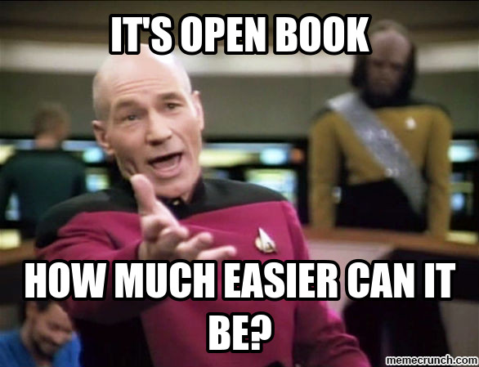
Records Reviews
Records Reviews – Will consist of a review of all project records and documentation for the project. (I will provide a copy of the checklist that I use!)

Slide 10
Material Certification & Project Closeout
In order to achieve project final acceptance, the NCDOT (Materials & Test Unit) will need to certify your project (requested by an NCDOT-1446B form by NCDOT). Please make sure all records are available for their review.
2 CFR 200 (aka: Supercircular) - Requires that projects be closed out 15 months after the “End Date” established and documented on the FHWA Authorization.
Note to NCDOT & Municipalities: Please schedule M&T’s review, the punch list walk through, final invoice, etc. as soon as you can in the final acceptance process to ensure proper (and timely) project closeout.
If timeframes are not met, the Supercircular states that ALL project funds shall be taken back.

Slide 11
Don’t Be Afraid To Ask For Help!
Remember: If you have questions, run in to a problem or don’t know how to handle something, please ask your NCDOT partners. They are there to help you and to keep you out of trouble!

Slide 12
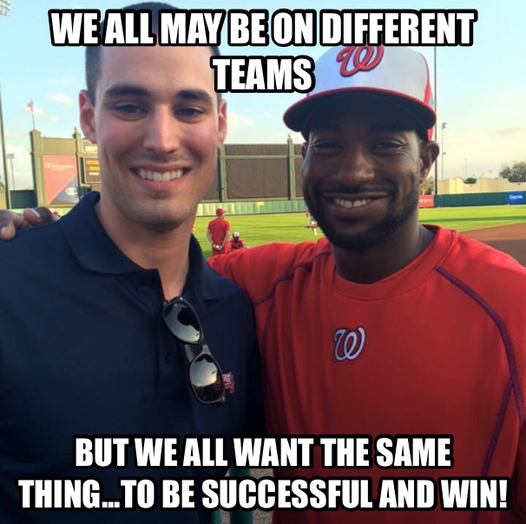
Teamwork
“It is my hope that when funds are given to a municipality, that they keep all of them and a great project is created. When I have to take Federal funds back from a municipality, I take it personally. It’s a bad day at the office for me. It means I failed…we failed in some way. That’s a bad day for everyone.” – Tammy Richards

Slide 13
Questions?
Tammy Richards
FHWA – Local Programs Manager
(919) 747-7004
Tammy.Richards@dot.gov

