Slide 1
LOCALLY ADMINISTERED PROJECTS
DCHC MPO – August 31, 2016
Durham – Chapel Hill - Carrboro
Sheila Gibbs, Divisions 5 & 7

Slide 2
Local Programs Management Office LPM Organization
Derrick Weaver, PE, Manager
Program Management Office
Program Consultants
Sheila Gibbs (Divisions 1 – 7)
Marta Matthews (Divisions 8 – 14)
Contract Officers
Madeline Rawley (Divisions 1 – 4 and 6)
Lee Ann Billington (Divisions 5, 7 – 9)
Cathy Dragonette (Divisions 10 – 14)

Slide 3
Division Project Managers
14 Transportation Divisions across the State
DCHC is within parts of Divisions 5 and 7
Division 5 Mike Kneis, PE, Division Project Development Engineer
Division 7 Donnie Huffines, Division Project Manager
Notes:
The Department is going thru some reorganization. Mike Kneis has currently received the position as Division Project Development Engineer and is continuing to assist as Project Manager until he can fill his position.

Slide 4
LPMO Website
https://connect.ncdot.gov/municipalities/Funding/Pages/default.aspx
The Department has a website for internal and external customers to utilize for information.
For Local Projects you will click on the “Local Governments” then Local Projects.
The website provides resources and links to other funding areas, project guidance, templates and forms.

Slide 6
NCDOT
LOCAL PROJECT DELIVERY

Slide 7
Typical Project Delivery Steps
Agreement
-------------Preliminary Engineering Authorization-------------
Procuring Professional Services
Environmental Document (required)
Plans (required)
-------------Right of Way Authorization-------------
Right of Way Acquisition
Utility Relocation
Right of Way Certification (required)
Contract Proposal and Estimate (PS&E) (required)
-------------Construction Authorization-------------
Advertise and Let Construction Contract
Construction & Administration
Final Inspection (required)
Final Reimbursement
Notes:
This is a simplified implementation process that hits the major milestones of a standard construction project. Note the red funding authorizations – in order for a Local Government to receive reimbursement for any of these activities, authorization must occur before those activities occur and expenses are incurred.
The bold items indicate major milestones for a project within that phase and these items must be complete before moving to the next phase.
The italicized items are other items that typically occur during a phase.

Slide 8
Typical Project Delivery Timeframes
AGREEMENT FULLY EXECUTED & FUNDING AUTHORIZED
Average – 3 to 6 months from Notice of Award by CAMPO
Necessary at any point in the process
Change in funding
Change in scope
Addition of a new phase
ACQUIRING PROFESSIONAL ENGINEERING FIRM
Average – 8 months from date of PE authorization
DEVELOPMENT AND APPROVAL OF ENVIRONMENTAL DOCUMENT
Average – 8 months from date of executed agreement
OBTAIN ROW CERTIFICATION
Average – 8 months from date of executed agreement
CONSTRUCTION FUNDING AUTHORIZED
Average – 11 months from date of executed agreement
CONCURRENCE IN AWARD
Average – 4 months from date of authorization

Slide 9
Agreement
Cannot be initiated until funding is programmed in the STIP in correct year.
Executed between NCDOT and the Local Governmental Agency.
Includes provisions that LGA must comply with in order to receive reimbursement.
Includes funding, time frames, scope of work, and responsibilities.
Funding Authorizations cannot occur until a fully executed agreement is in place.
Notes:
The Agreement is the funding tool that enables NCDOT to reimburse the LGA for the scope of work. Runs on DOT’s Board Agenda, runs on local board agenda

Slide 10
Funding Authorization
The request for Funding Authorization is a way of asking FHWA “Mother, may I?” before you do work.
Work done before funding authorization is not reimbursable.
Funding authorization “starts the clock” of activity
Reimbursement requests (shown later) must be made to show activity.
Agreement will reflect reimbursable phases.
The LGA will submit funding request in the new Project Management Tool.
Notes:
You must request authorization AND receive Notice of Authorization before proceeding with each phase that is reimbursable.
For PE – cannot solicit for professional services

Slide 11
Professional Services
All professional services procurement must be in accordance with 23 CFR 172.
New, specific guidance on solicitation, selection, negotiation, and administration of contracts.
Read 23 CFR 172
Review Professional Services section of Agreement and Handbook
Utilize DOT’s template for a Request for Letters of Interest (RFLOI)
Allow sufficient time to on-board a PEF – it usually takes longer than you think.
Notes:
(Bullet 1): Basically, this means that solicitation and selection of professional services (i.e. engineering and design-related services) must follow a qualifications-based selection process. This is also in line with NC General Statutes concerning procurement of professional services and NCDOT’s policies and procedures.
(Bullet 2): The LGA will be required to have their own adopted procurement procedures to be reviewed by NCDOT, or they will also have the option to adopt NCDOT’s. We’re working on revising our current procedures to make it easier for an LGA to adopt ours.
The LGA will be required to have a cost estimate for professional services, prior to negotiating a contract.
All documentation must be maintained by the LGA.
(Last bullet): What this means is that we will assist, but we will not step in and negotiate on the LGA’s behalf.

Slide 12
Issues
Issues we’ve seen related to securing professional services:
Not knowing what work codes are needed when advertising for firms – guidance on website
Underestimating the cost of a PEF
Underestimating the amount of time to on-board a PEF (make sure to factor in review time by NCDOT and by the Town).

Slide 13
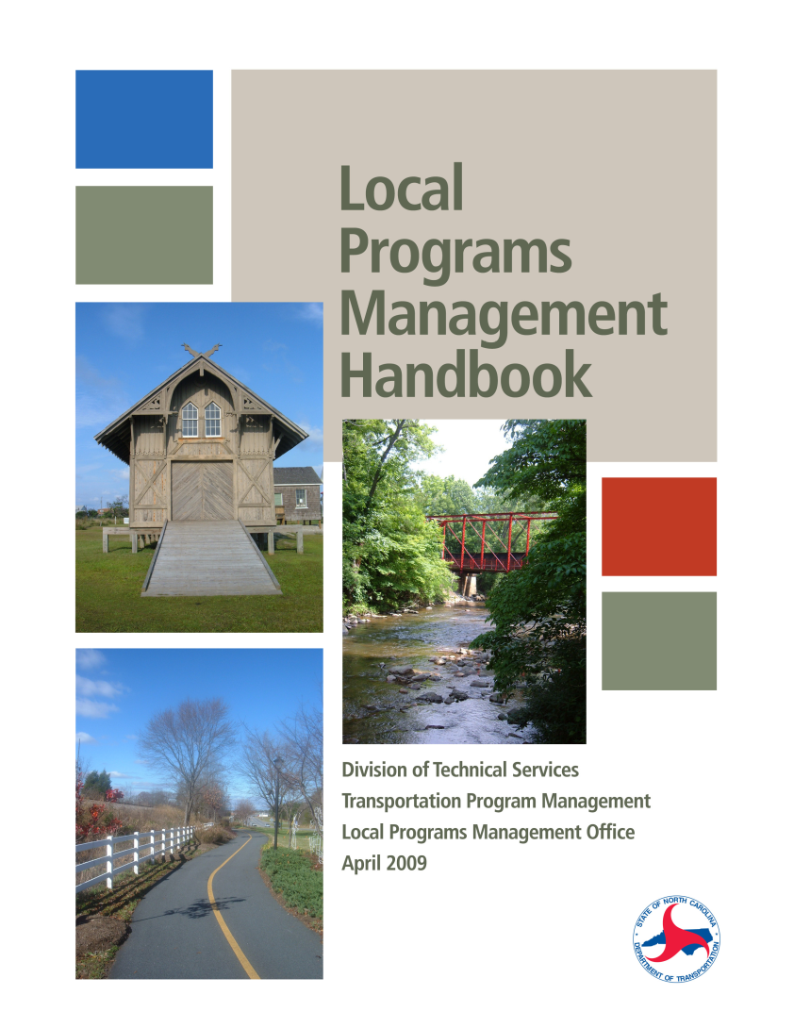
Local Programs Handbook
https://inside.ncdot.gov/TransportationServices/Localprograms/Pages/default.aspx

Slide 14
Project Management Tool
If you are awarded a project, you will need to request an agreement and manage the project in the Local Projects Management Tool.
Complete the Local Programs Management System Access Authorization Form (LPMO Security Form)
Find the Form at the Local Projects Website:
https://connect.ncdot.gov/municipalities/Funding/Pages
Complete the Form & Submit to lpmo@ncdot.gov
NCDOT-SAP Will Notify You of Your New User ID and Temporary Password
You Will Log Into the System & Change Your Password

Slide 15
System Logon
Local Projects System Portal Access:
https://partner.ncdot.gov
On September 7, 2016 there will be a new login page known as the Enterprise Business Services (EBS) Portal
www.ebs.nc.gov
Bookmark This Site for Future Reference
Depending On Your Role Within the LGA, You May See Other Systems Available To You

Slide 16
System Help Documentation
Available From Any Screen
Comprehensive and Easy to Follow
Details for Each Action in the System
PDF Format - Available for Easy Printing

Slide 17
Questions
Any Questions ????
Sheila Gibbs
NCDOT Local Programs Management Office
919-707-6625
sgibbs@ncdot.gov

