Slide 1
Essential Requirements of the Uniform Act for Local Public Agencies

Slide 2
Learning Outcomes
At the end of this lesson, you will be able to:
Identify the rights conveyed in the 5th and 14th amendments to the U. S. Constitution
State the purposes of the Uniform Act.
Explain who must follow the Uniform Act
Interpret when an Agency must follow the Uniform Act

Slide 3
When Using Federal-aid funds,
there are Strings Attached……

Slide 5
Government Property Acquisition: Some History

Slide 6
The power of any sovereign government
to take private property without
the consent of the owner.

Slide 7
U. S. Constitutional Limitations on Power of Eminent Domain
5th Amendment
“…nor shall private property be taken for public use without just compensation.”
14th Amendment
“…nor shall any State deprive any person of life, liberty, or property, without due process of law…”

Slide 8
Legal Authority to Acquire Property
State Administrative Regulation
State Laws
Uniform Act Implementing Regulations
State Constitution
Federal Uniform Act
U.S. Constitution 5th and 14th Amendments

Slide 9
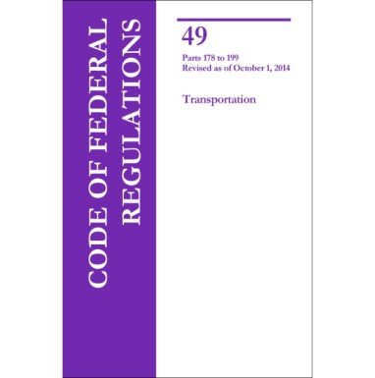
Uniform Act
Uniform Relocation Assistance and Real Property Acquisition Policies Act of 1970, as amended (Public Law 91-646)

Slide 10
Where can you find the law and the rules to carry out the law?
The law is codified in 42 U.S.C. 4601
The regulation governing the law is found in
49 CFR 24
http://www.ecfr.gov

Slide 11
Uniform Act Twofold Purpose
Establish uniform and equitable land acquisition policies for Federal and federally-assisted programs.
Ensure the uniform and equitable treatment of persons displaced from their homes, businesses or farms by Federal and federally-assisted programs.

Slide 12
Who Must follow the URA?
Any Federal department or agency in the executive branch
Any department or Agency of a State or a political subdivision of a State
Any entity with the authority to acquire property by eminent domain under Federal or State law
12
Notes:
Over the next two days, we will discuss the appraisal and acquisition process, along with the relocation process. Note that in the next slides, the discussion will focus on both the regulations that implement the Uniform Act (i.e., 49 CFR Part 24), and on regulations that apply only to FHWA and pertain to the administration of the Right of Way program (i.e., 23 CFR Part 710).

Slide 13
When Must an Agency Follow The Uniform Act?
When any phase of a project is federally-funded
When real property is acquired
When property owners and/or tenants are displaced as a direct result of land acquisition, demolition or property redevelopment

Slide 14
Major Components of the Uniform Act
Public Law 3.JPG
Notes:
“The Uniform Act consists of three titles, or parts. Title I, the General Provisions, contains definitions and eligibility as a displaced person.”
“Title II of the Uniform Act addresses relocation assistance. This part contains housing payments for owners and tenants and assures that comparable replacement housing is provided prior to displacement. This section also includes moving and related expenses, as well as relocation planning and advisory services.”
“Although Title III is labeled as Uniform Real Property Acquisition Policy, this section includes appraisal and compensation issues. Offers must be for at least the fair market value of the property; an Agency cannot make “low-ball” offers.
Negotiation standards are established in this part, which include the requirement for an appraisal, an appraisal review, a written offer to the owner, and giving the owner time to consider the offer. This part also provides an assurance that residential occupants and business owners will receive a written notice giving them at least ninety days to move.”

Slide 15
Basic Requirements of 49 CFR Part 24 (URA)
Appraise FMV of property to be acquired
Agency Review and approval of appraisals
Agency Determination of FMV
Offer no less than FMV, in writing
Negotiate in Good Faith
Avoid litigation if possible
Relocate residences, businesses, others
Provide relocation Advisory Services

Slide 16
A Quick Review
What rights do the 5th & 14th amendments convey?
What is the two-fold purpose of the Uniform Act?
Who must follow the Uniform Act?
When must an Agency must follow the URA Act?
What do you risk if there is non-compliance?

Slide 18
Contact Information:
Michael Dawson
Realty Officer
FHWA NC Division
310 New Bern Ave, Suite 424
Raleigh, NC 27601
919-747-7009
michael.dawson@dot.gov

