Slide 1
Safe Streets and Roads for All (SS4A) Vision Zero Action Plan – Scope of Work
Stakeholder Forum – July 26, 2023

Slide 2
Transportation Fatalities / Year

Slide 3
War Fatalities / Year
War | American Fatalities | Number of Years | American Fatalities/Year
World War II | 291,557 | 5 | 58,311
Civil War | 214,938 | 5 | 42,988
World War I | 53,402 | 2 | 26,701
Korean War | 33,656 | 4 | 8,414
Vietnam War | 53,220 | 21 | 2,534
2021 U.S. Crash Fatalities = 42,939
2022 U.S. Crash Fatalities = 42,795
Wikipedia.com, nhtsa.gov

Slide 4
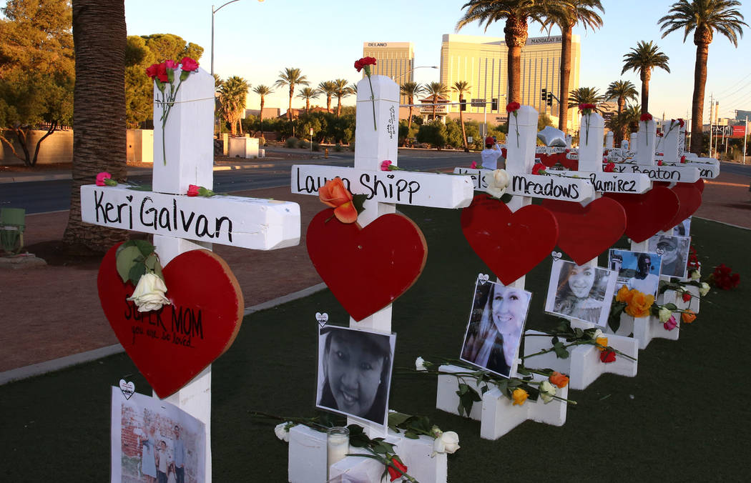
Recent Tragedy Comparisons
Tragedy | Fatalities | 2021 & 2022 U.S. Fatality Crashes
9/11 | 2,996 | 1 / 25.5 Days
One October | 58 | 2.0 / Day
Wikipedia.com, nhtsa.gov
Time.com
lvrj.com

Slide 5
Disproportionately Impacted

Slide 6
Vulnerable Users
City of Las Vegas Vision Zero Action Plan

Slide 7
Vulnerable Users
City of Las Vegas Vision Zero Action Plan

Slide 8
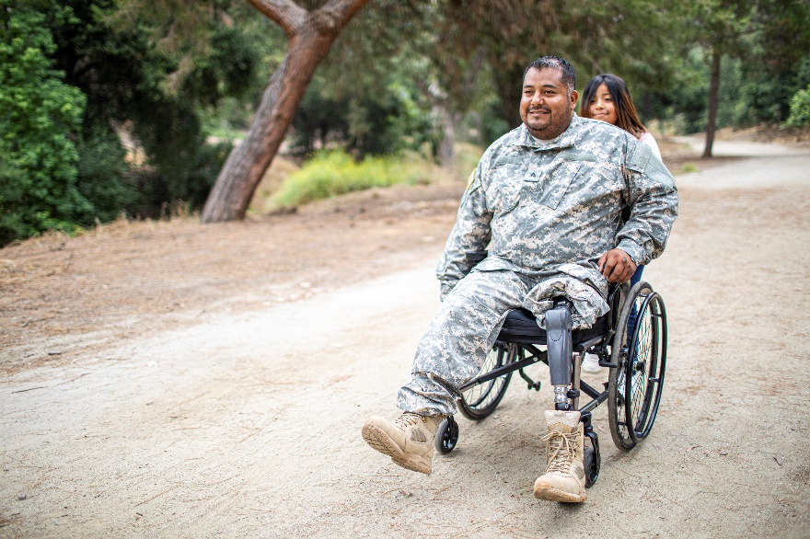
Communities of Concern
Low Income
People with Disabilities
Seniors
Limited English Proficiency
Minority

Slide 9
United States Department of Transportation (USDOT)

Slide 10
Safety is Number 1 Priority
Infrastructure Investment & Jobs Act (IIJA)
$550B
52% Transportation
Infrastructure
Emphasis on Safety,
Equity, Resiliency

Slide 11
Safe Streets and Roads for All (SS4A)

Slide 12
2022 – 2026: $5B
Awarded to Support Planning, Infrastructure, Behavioral,
& Operational Initiatives to Prevent Death & Serious Injury
Crashes Involving All Roadway Users

Slide 13
DCHC MPO
Awarded SS4A Grant to Develop a Vision Zero Action Plan

Slide 14
What is Vision Zero

Slide 15
Vision Zero
Vision Zero is a strategy to eliminate all
traffic fatalities and serious injuries, while
increasing safe, healthy, and equitable
mobility for all. First implemented in
Sweden in the 1990s,Vision Zero has
proved successful across Europe – and
now it’s gaining momentum in major
American cities.

Slide 16
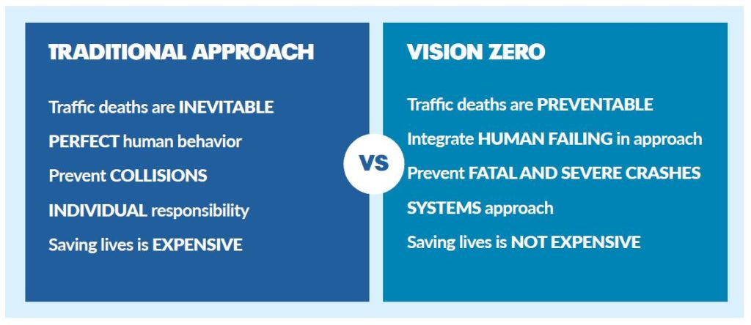
Reactive vs. Proactive
https://visionzeronetwork.org/about/what-is-vision-zero/

Slide 17
DCHC MPO SS4A Vision Zero Action Plan Scope of Work

Slide 18
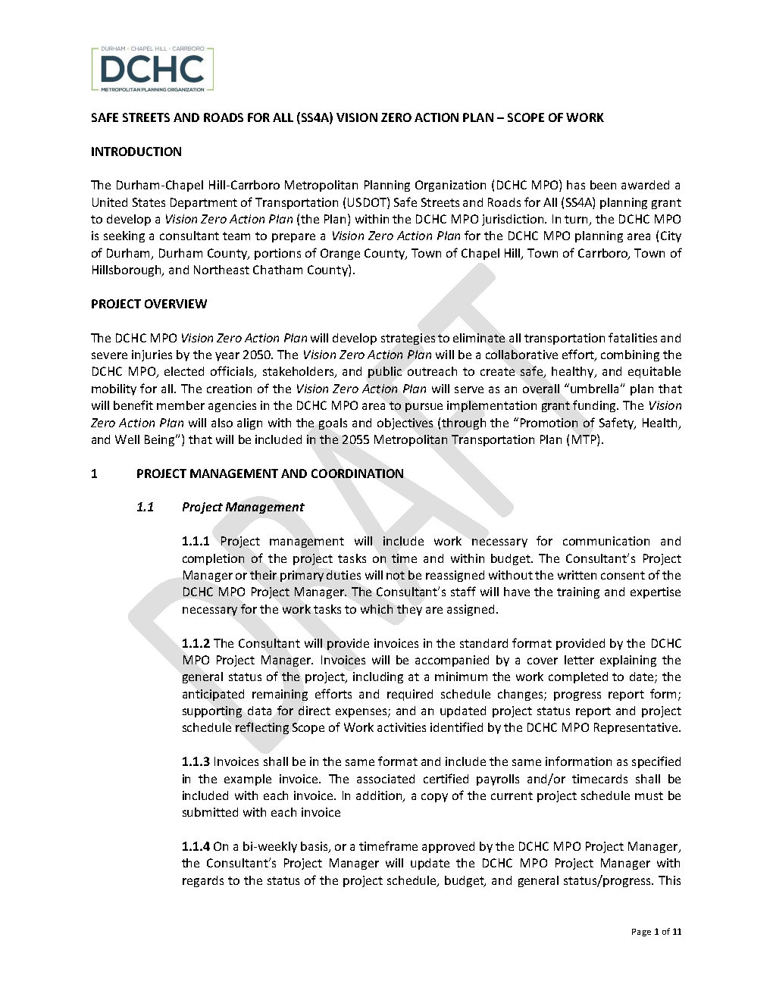
Vision Zero Action Plan Scope of Work
1. PROJECT MANAGEMENT AND COORDINATION
1.1 Project Management
1.2 Kickoff Meeting and Progress Meetings
1.3 Coordination with Project Technical Advisory Committee (TAC)
1.4 Public Information and Neighborhood Meetings
1.5 DCHC MPO Vision Zero Action Plan Webpage Updates
1.6 Public Surveys
1.7 Local Agency Technical Committee and Board Updates

Slide 19
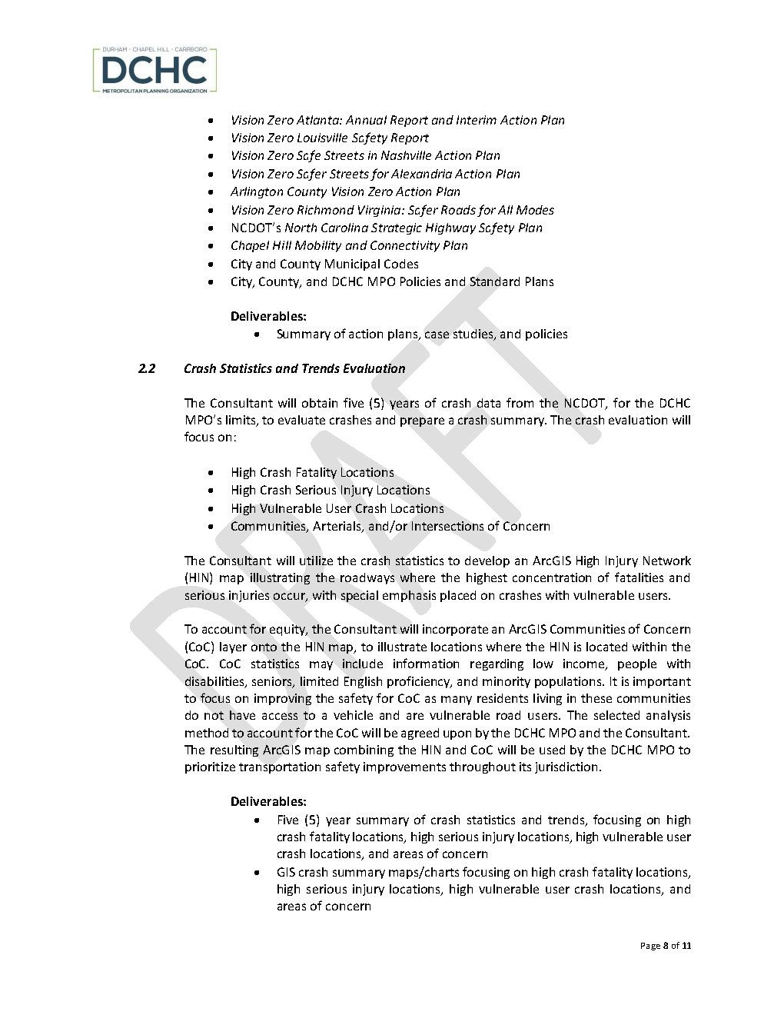
Vision Zero Action Plan Scope of Work
2 EXISTING CONDITIONS ANALYSIS
2.1 Review Policies, Plans, and Studies
2.2 Crash Statistics and Trends Evaluation

Slide 20
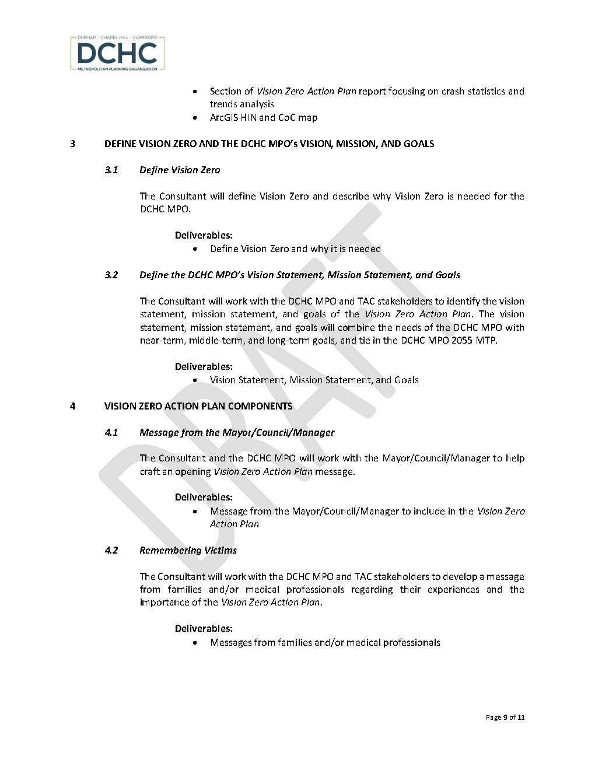
Vision Zero Action Plan Scope of Work
3 DEFINE VISION ZERO AND THE DCHC MPO’s VISION, MISSION, AND GOALS
3.1 Define Vision Zero
3.2 Define the DCHC MPO’s Vision Statement, Mission Statement, and Goals

Slide 21
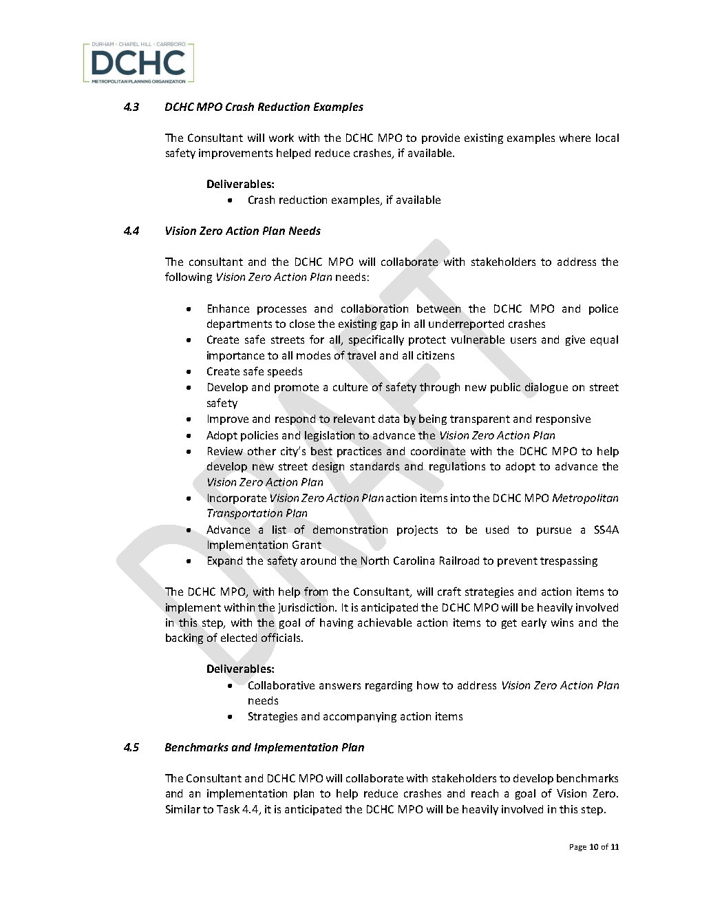
Vision Zero Action Plan Scope of Work
4 VISION ZERO ACTION PLAN COMPONENTS
4.1 Message from the Mayor/Council/Manager
4.2 Remembering Victims
4.3 DCHC MPO Crash Reduction Examples
4.4 Vision Zero Action Plan Needs
4.5 Benchmarks and Implementation Plan
4.6 Central Pines Regional Council Making All Communities Safe in the Triangle Action Plan

Slide 22
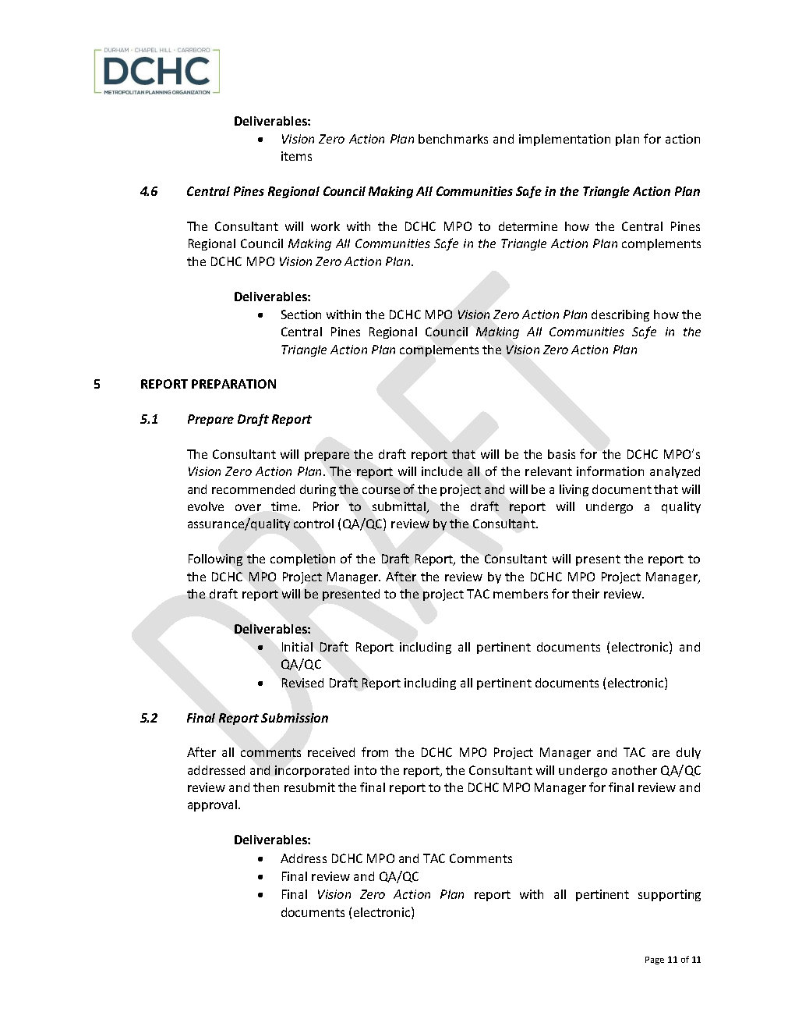
Vision Zero Action Plan Scope of Work
5 REPORT PREPARATION
5.1 Prepare Draft Report
5.2 Final Report Submission

Slide 23
SS4A Next Steps

Slide 24
SS4A Next Steps
Living Document
- Continue to Update
- Be Transparent
About Results
Demonstration Projects
- Provide a List for Next
Round of Funding

Slide 25
Questions for Stakeholder Forum

Slide 26
Scope of Work Questions
Thoughts on Virtual Meetings?
How do you currently account for Communities of Concern?
Other Organizations and/or Departments to invite?
Suggested Scope Edits?
Any Other Questions?

Slide 27
Questions?

Slide 28
Empathy

Slide 29
Please Use Compassion & Drive Safe
Remember…
Everyone has
family & friends
who want to
see them again –
safe driving will
protect you,
your family/friends,
& other road users

Slide 30
Thank You & Action Item

Slide 31
Thank You & Action Item
We invited you because
YOU ARE IMPORTANT
and
YOUR INPUT IS MEANINGFUL
Action Item:
Please have any comments back to DCHC MPO by Monday, July 31st

Slide 32
Adjourn

Slide 33
Scott Rickert
Scott.Rickert@AtkinsGlobal.com
Work: (702) 551-0296
Cell: (702) 813-9787

